Slide 1
Progress Report 2
Siti Nurafifah
Alice Yap

Slide 2
Review of Progress Report 1
R language
Accessing Github
Social Network Analysis
Accessing MySQL workbench through R
Network building on Pajek
2 tasks in R : - people-pre-analysis.R
- repo-pre-analysis.R

Slide 3
PR2- Agenda
What have we learned?
What have we done so far?

Slide 4
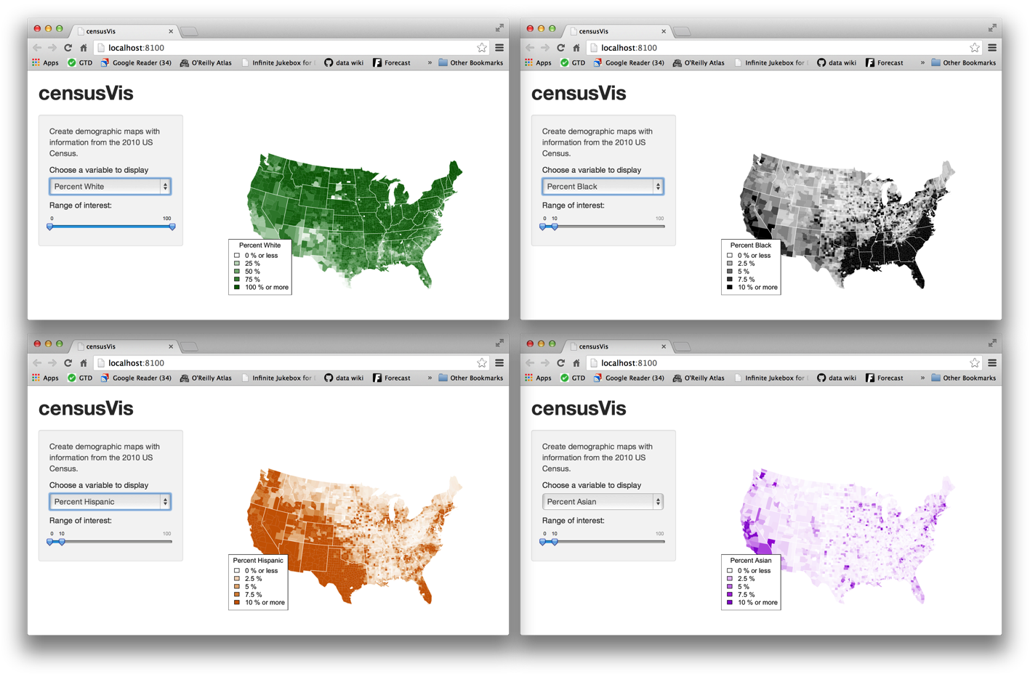
Creating Shiny App in RStudio
What is Shiny?
-A web application framework for R.
-Turn your analyses into interactive web applications.

Slide 5
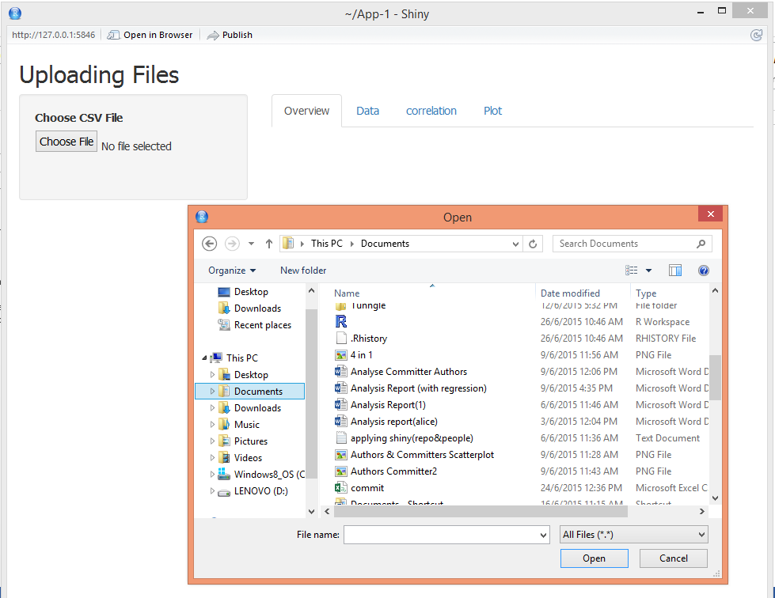
What have we done?
In R, we wrote an application in Shiny that will :
1.Let the user select a
folder location

Slide 6
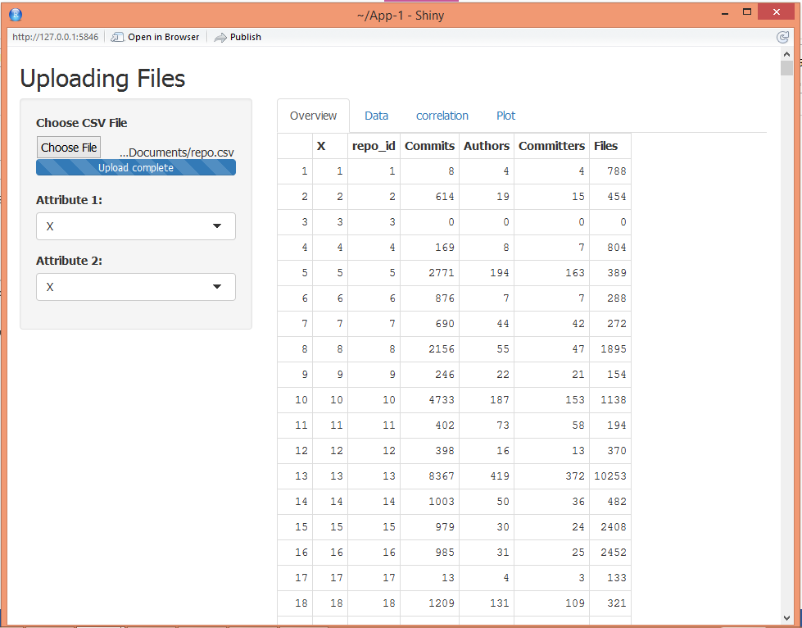
2. Read a csv file from that folder location
1.
2.

Slide 7
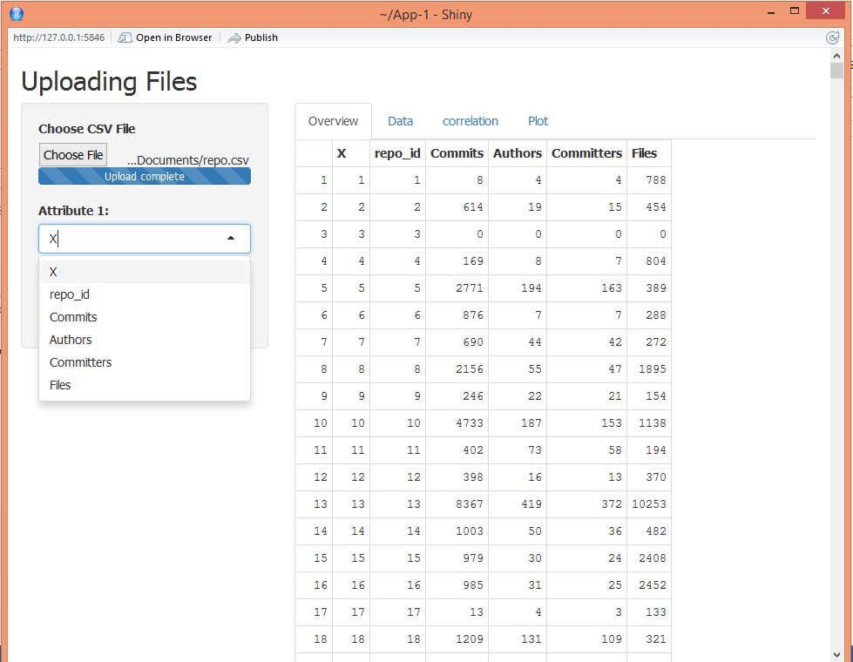
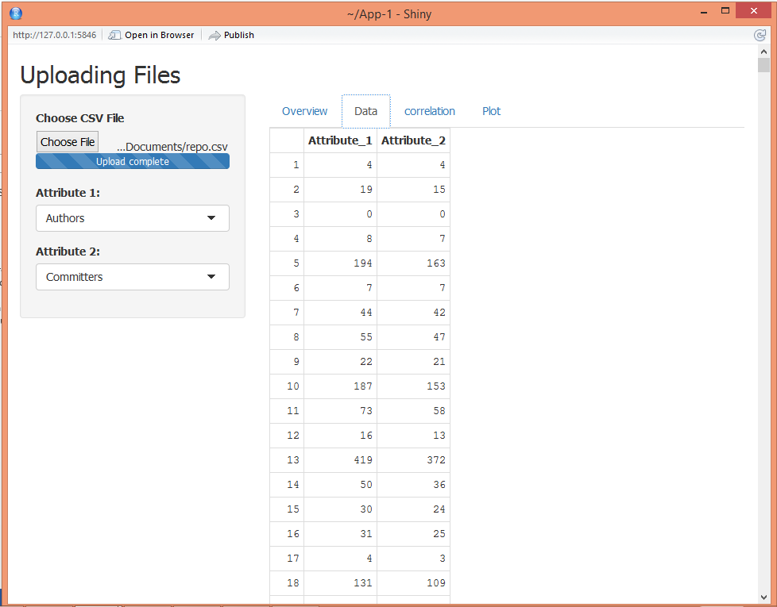
3. Show the csv file columns in two drop down lists. Let the user select one column from each list.
1.
3.
2.

Slide 8
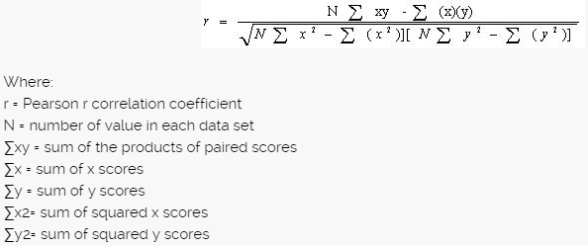
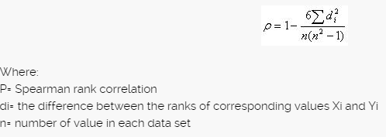
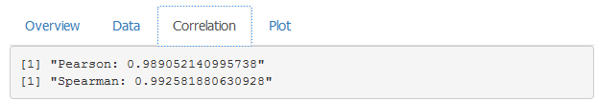
4a. Calculate both the Pearson and Spearman correlation coefficients between the two columns selected by the user and show it.
The output:
Spearman
Pearson

Slide 9
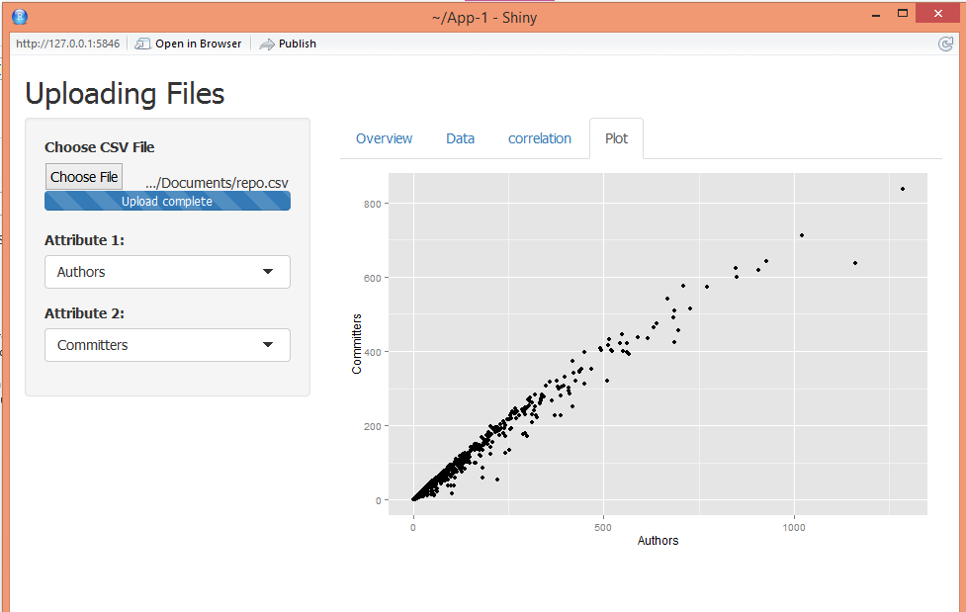
4b. Draw a Scatterplot of the two columns select by the user and show it

Slide 10
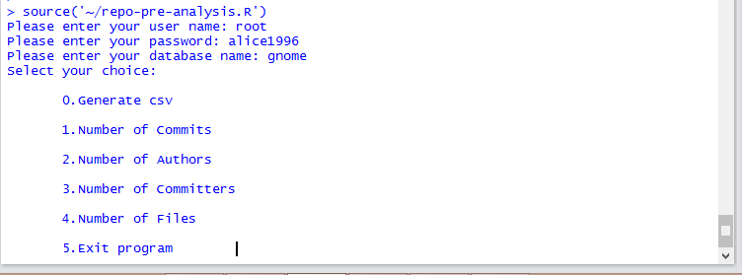
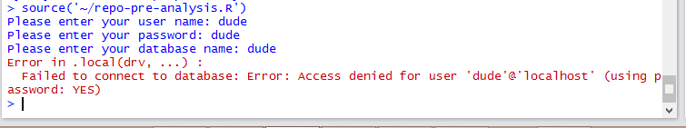
Modifying people-pre-analysis & repo-pre-analysis
Prompt for database name, username & password in R:
If invalid,
error message will appear:
User input
If valid, interactive
menu will be shown

Slide 11
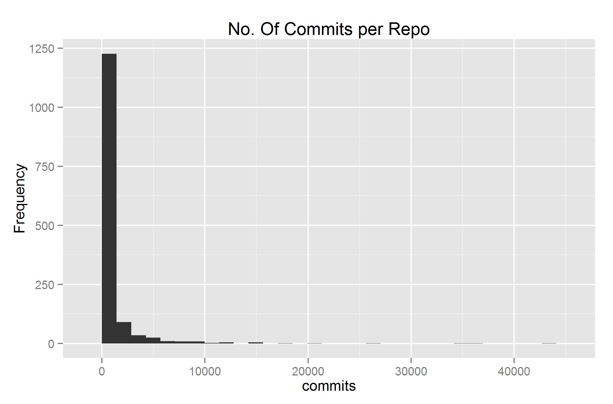
Writing a Report- subset of repositories
To start off with the analyzing, we need to find out which set of repo to analyze from. To proceed with that, we divided the parameters and find out each Pearson and Spearman.
Firstly, we compare the relationship
between the repository and the number
of commits. Looking at the histogram,
it is a right skewed distribution
where the mean is greater than the median.

Slide 12
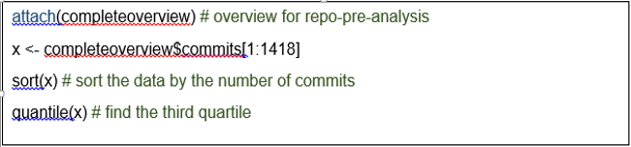

Then, we look at the median and the third quartile. To find the third quartile, we have to range the number of commits in order. To do this, in R:
The output given was: This shows that the
third quartile is 545.25.

Slide 13
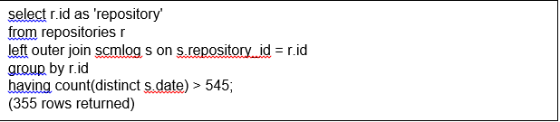
Fetch the query number of commits > third quartile
To do this, using SQL query:
With this, it subsets the set of repository according to the number of commits more than the third quartile.

Slide 14
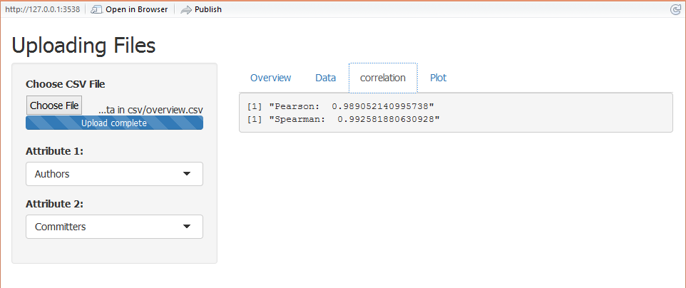
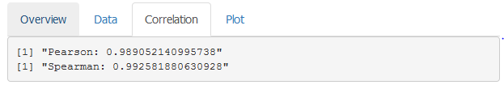
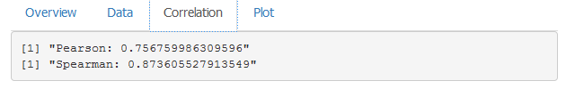
Using Shiny App in R:
We compare the Pearson and Spearman correlation coefficient:

Slide 15
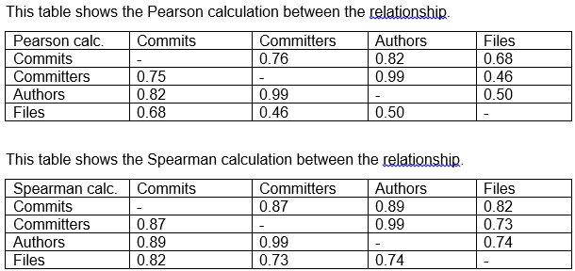
Overview of the Pearson & Spearman

Slide 16
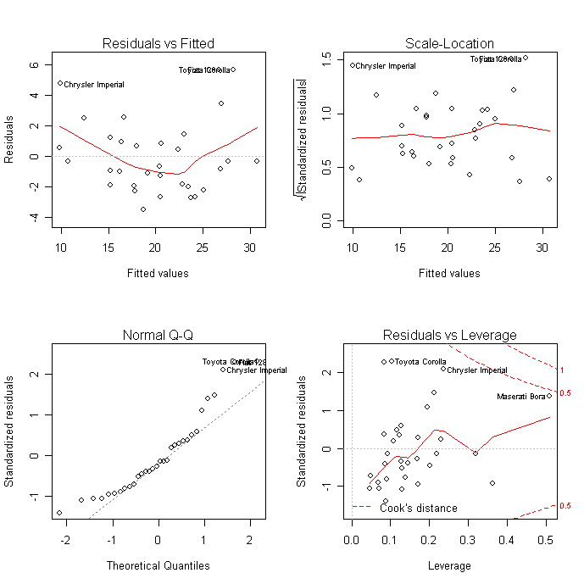
Regression
What we learn?
Linear Regression
Multiple Linear Regression

Slide 17
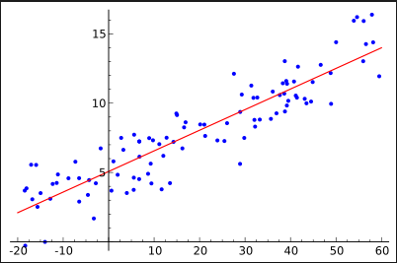
Linear Regression
In statistics, linear regression is an approach for modeling the relationship between a scalar dependent variable y and one or more explanatory variables (or independent variable) denoted X.

Slide 18
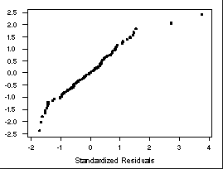
Multiple Linear Regression
Multiple linear regression attempts to model the relationship between two or more explanatory variables and a response variable by fitting a linear equation to observed data.
Every value of the independent variable x is associated with a value of the dependent variable y.

Slide 19
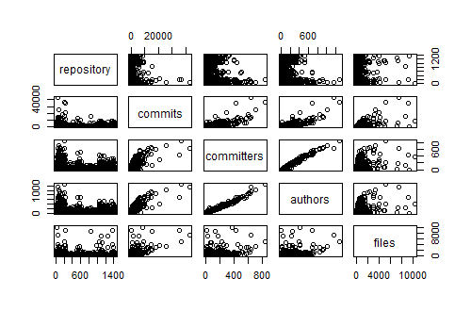
Writing a Report - Regression
Before fitting our regression model we want to investigate how the relationship of the variables related to one another.
To do this, we can graphically construct scatter plots of all pair-wise combinations of variables in the data frame.

Slide 20
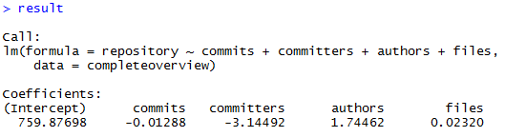

To fit a multiple linear regression model with repository as the response variable and Number of commits, committers, authors as the explanatory variables, use the command:
When calling the function result:
This output indicates that the fitted values is given by
$\hat{y}$ = 759.87698 -0.01288$x_{1}$ -3.14492$x_{2}$ + 1.74462$x_{3}$ + 0.02320$x_{4}$

Slide 21
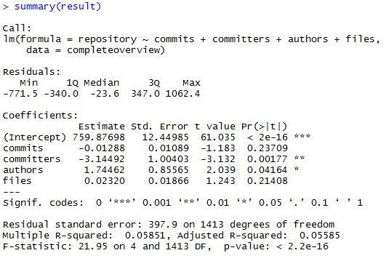
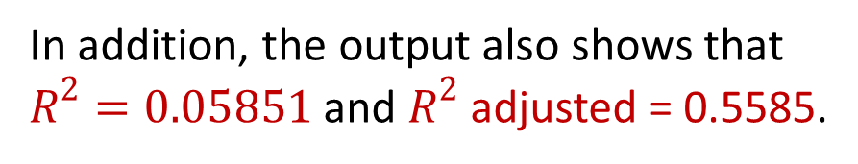
We begin by testing whether the explanatory variables collectively have an effect on the response variable.
If we can reject this hypothesis, we continue by testing whether the individual regression coefficients are significant.
The output shows that F=21.95 (p < 2.2e-16)
indicating that we should clearly reject
the null hypothesis
In addition, the output also shows that
$R^{2}=0.05851$ and $R^{2}$ adjusted = 0.5585.

Slide 22
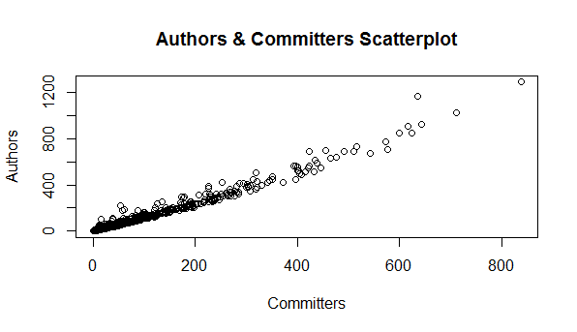
Drawing a Scatterplot
We are interested in the variables authors and committers relationship. We can construct a scatterplot of committers against authors :

Slide 23
Measure the strength of the relationship
This shows that the authors and committers variables have a strong positive relationship.

Slide 24
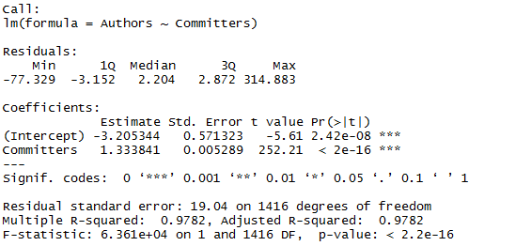
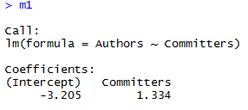
Running the Regression
The regression command is lm for linear model. We will store that model in a variable called m1. The order of the variables is dependent followed by a tilde "~" followed by a list of independent variables.

Slide 25

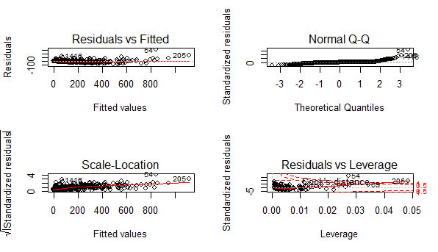
Looking at the diagnostic plot of the residuals
We can say that the regression line is flat which means
Authors can be expressed as a linear function
of Committers and the variation of observations around
the regression line is constant.

Slide 26

Creating network builder in Java
Using Java, write a program that does the following:
1. Prompt the user for a folder location where the program expects to find two CSV files: repo.csv and people.csv, each containing a list repo and people ids respectively, one id in each row of corresponding files. If the program can not find one or both the files with the given names, it should give an error message.

Slide 27
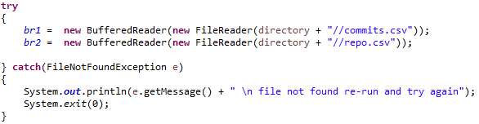
Reading the csv file using BufferedReader:
2. After accepting the files, the program should generate an undirected network as a Pajek file, where the vertices (nodes) are the people ids in the given people.csv file, and two vertices are connected by an undirected edge (link) if both persons have committed to at least one repository whose id is given in the given repo.csv file.
The number of different repositories that both of have commented on is the weight of each edge.

Slide 28
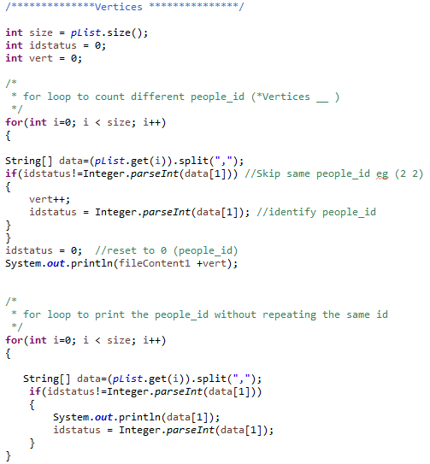
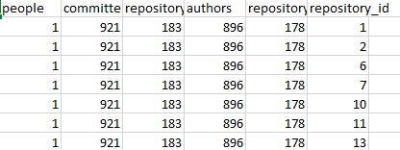
In order to create a network, we have to find out
which repository each person commits to.
One person can commit to more than
one repository.

Slide 29
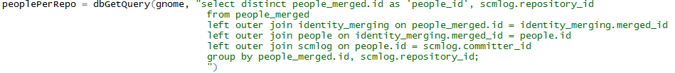
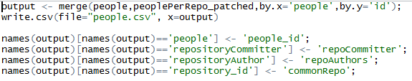
Process of fetching the query
This will give us the output on which repository each person committed to.
After fetching the data, we have to merge with the original “people.csv” :

Slide 30
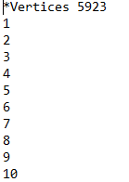
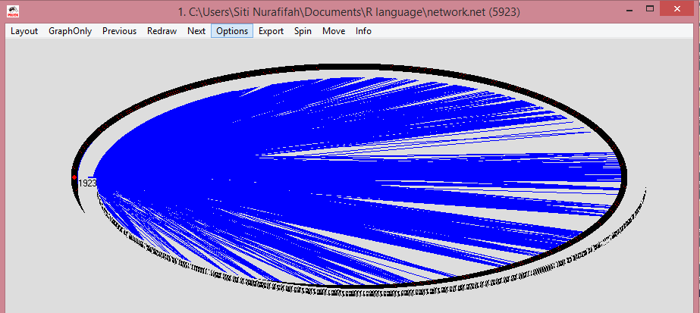

3. The program should output the Pajek file in the same folder location given by the user, and give a message that processing is complete.

Slide 31
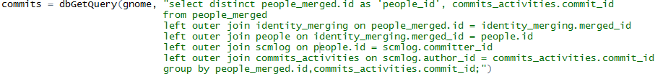
Other Network
After completing the network generation, we did other network that we can generate such as common commits between two developers.

Slide 32
Igraph in R
Igraph is a library and R package for network analysis.
The main goals of the igraph library is to provide a set of data types and functions for
1) pain-free implementation of graph algorithms,
2) fast handling of large graphs, with millions of vertices and edges,
3) allowing rapid prototyping via high level languages like R.

Slide 33
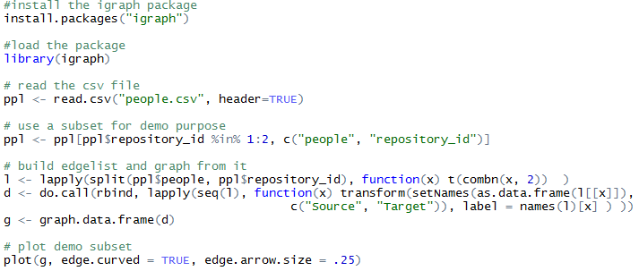
What have we done?
We did a subset of people.csv for demo purpose.
Firstly we load the package in R
Use a subset for demo purpose & build edgeList and graph from it:

Slide 34
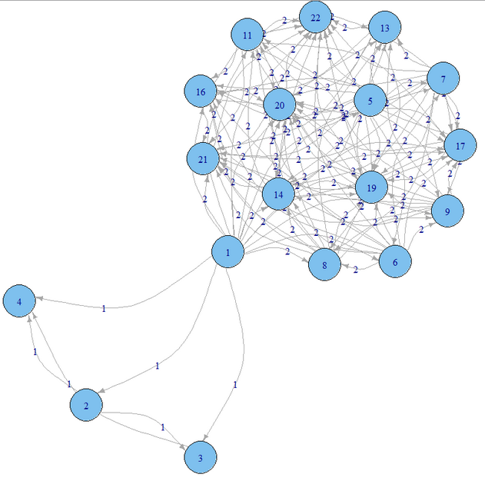
The output

Slide 35
Thank you.

